Slide 1
PID Controller Design and Tuning
Presented by Joe Driscoll and Isaac Hill

Slide 2
Problem and Requirements
Design a motor controller
Basic requirements
5% steady state error
< 10% overshoot
Closed loop response 50% faster than open loop

Slide 3
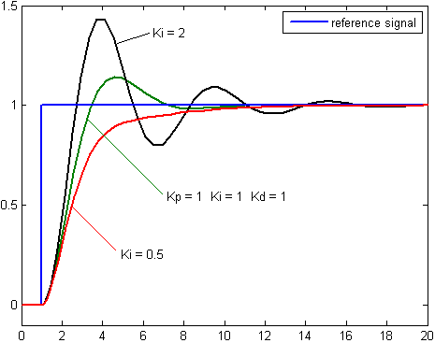
Solution
Use PID controller:
Adjustable/adaptable
Quick response time
Design focused heavily on response time
https://commons.wikimedia.org/wiki/File:Change_with_Ki.png
Notes:
Proportional, integral, derivative
The graph on the right shows how the controller can be changed with different values. This graph shows different values for only one of the variables.
More adjustable – multiple variables allows different ways to sense error, a lot of control over the response

Slide 4
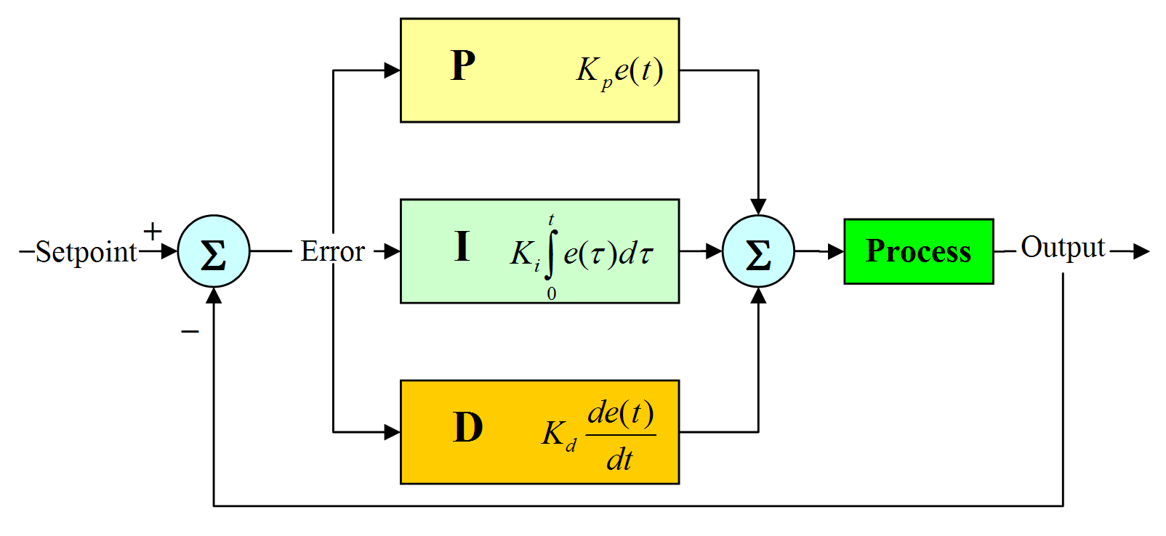
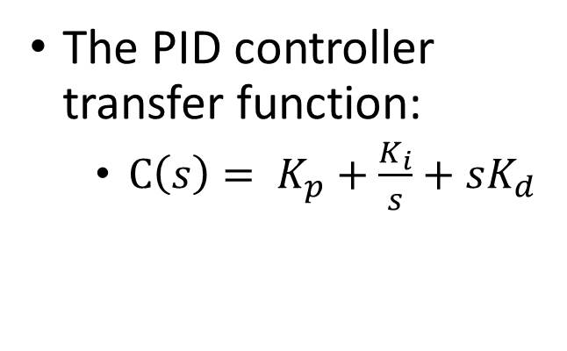
PID Controller
PID controller design:
proportional gain (K_{p}) – error sensitivity
integral gain (K_{i}) – steady state error
derivative gain (K_{d}) – stability and speed
The PID controller transfer function:
$C\left(s\right)= K_{p}+\frac{K_{i}}{s}+sK_{d}$
https://nicisdigital.wordpress.com/2011/06/27/proportional-integral-derivative-pid-controller/
Notes:
The proportional gain is what causes the controller to respond to different levels of error.
The integral gain lets the controller react to past error values. This eliminates any persistent error that the proportional gain does not correct.
The derivative gain estimates the future error. This constant helps eliminate any error at a faster pace.
Kp and Ki decrease rise time, but increase overshoot
Ki significantly decreases steady state error,
Kd improves stability and has minor effect on other variables
Proportional gain – sensitivity to error
Integral gain – reduces steady state error
Derivative gain – improves settling time and stability
S-domain = frequency domain
e(t) is error function.
We’ll actually use a discrete time domain, because computers are only capable of sampling

Slide 5
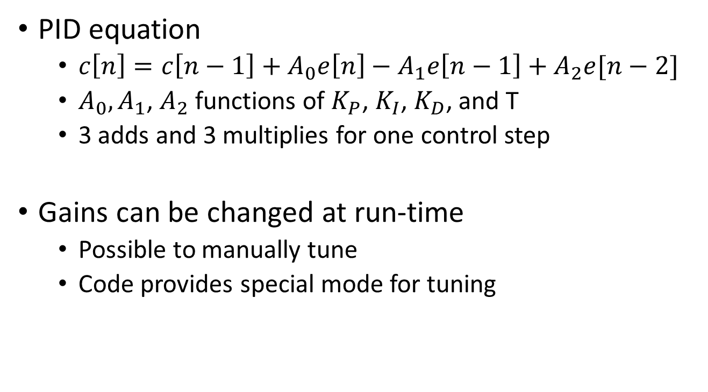
Discrete PID Equations
PID equation
$c\left[n\right]=c\left[n−1\right]+A_{0}e\left[n\right]−A_{1}e\left[n−1\right]+A_{2}e[n−2]$
$A_{0},A_{1}$, $A_{2}$ functions of $K_{P}$, $K_{I}$, $K_{D}$, and T
3 adds and 3 multiplies for one control step
Gains can be changed at run-time
Possible to manually tune
Code provides special mode for tuning
Notes:
Uses an array
Tuning

Slide 6
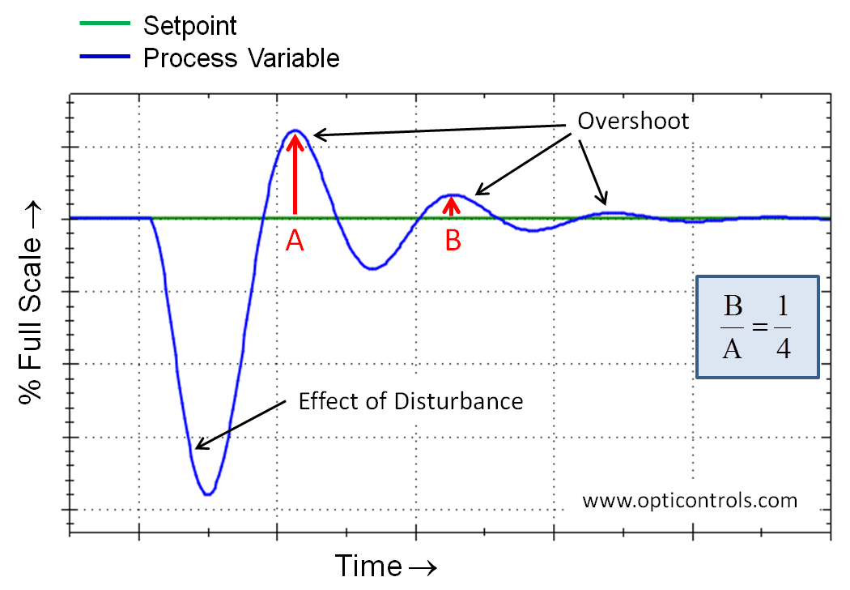
Tuning Approaches
Methods attempted/used
Cohen-Coon (most difficult)
Ziegler-Nichols
Manual tuning (least difficult)
Floating point unit difficulties
PID gains tend to be low
Used manual tuning rather than adapting system for small gains

Slide 7
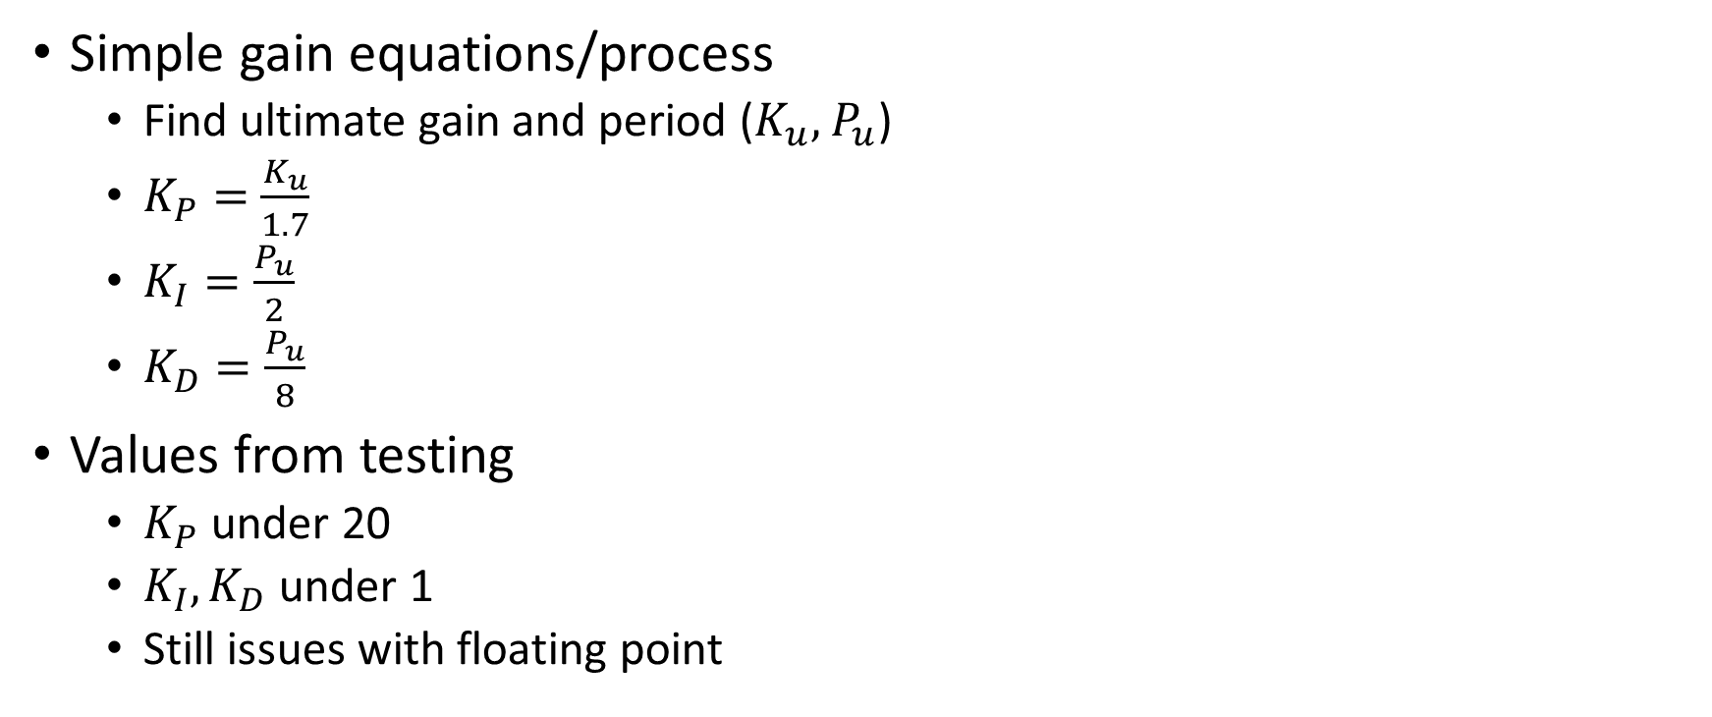
Ziegler-Nichols
Simple gain equations/process
Find ultimate gain and period ($K_{u},$ $P_{u}$)
$K_{P}=$ $\frac{K_{u}}{1.7}$
$K_{I}=\frac{P_{u}}{2}$
$K_{D}=\frac{P_{u}}{8}$
Values from testing
$K_{P}$ under 20
$K_{I},K_{D}$under 1
Still issues with floating point

Slide 8
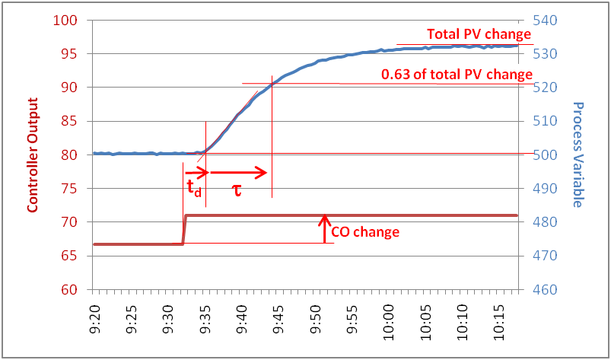
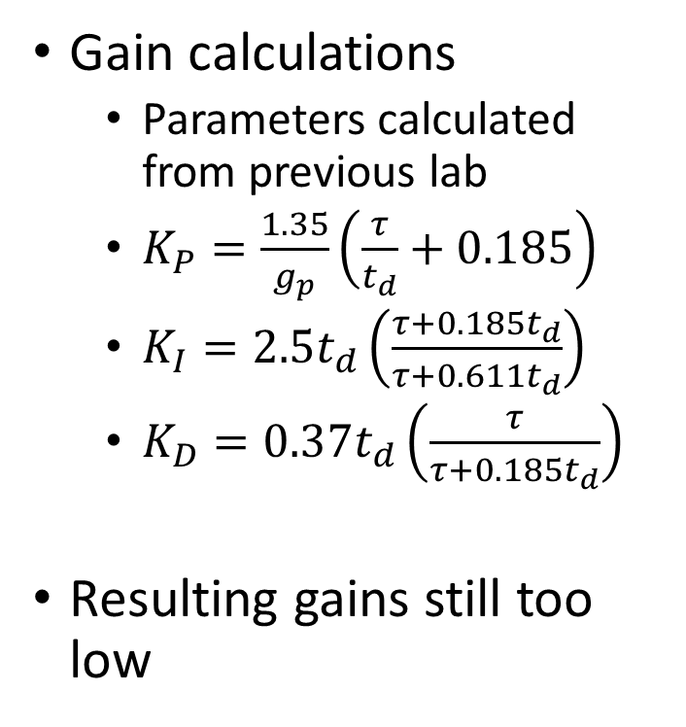
Cohen-Coon
Gain calculations
Parameters calculated from previous lab
$K_{P}=\frac{1.35}{g_{p}}\left(\frac{τ}{t_{d}}+0.185\right)$
$K_{I}=2.5t_{d}\left(\frac{τ+0.185t_{d}}{τ+0.611t_{d}}\right)$
$K_{D}=0.37t_{d}\left(\frac{τ}{τ+0.185t_{d}}\right)$
Resulting gains still too low
http://blog.opticontrols.com/archives/316

Slide 9
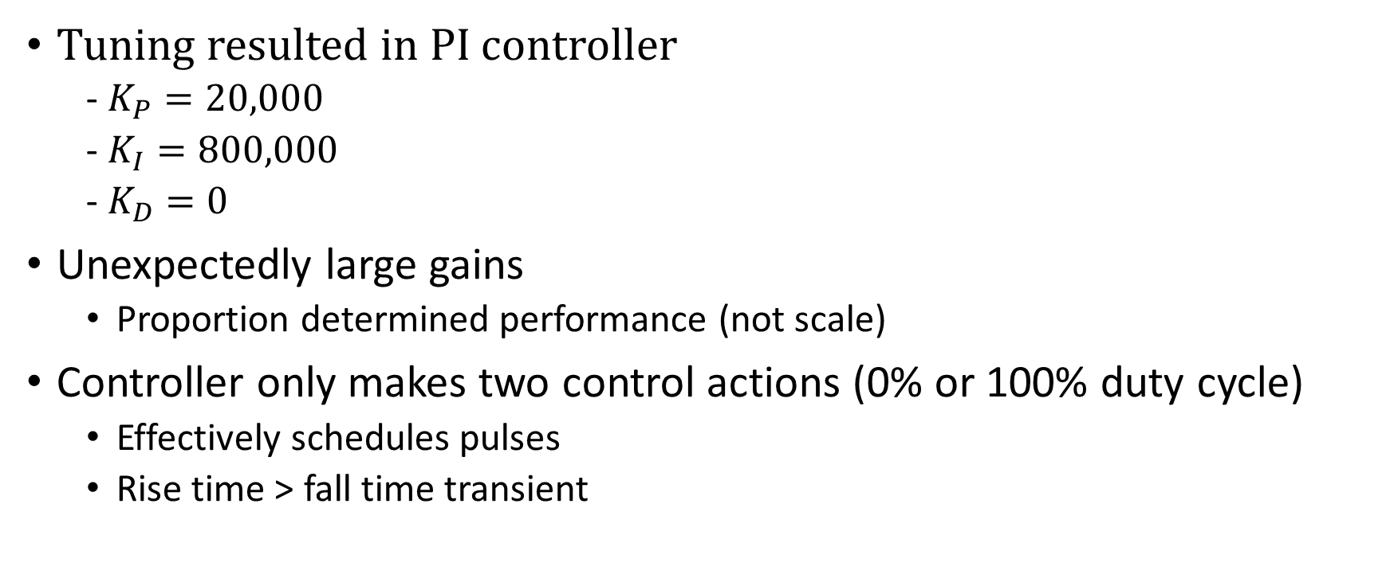
Tuning Results
Tuning resulted in PI controller
- $K_{P}=20,000$
- $K_{I}=800,000$
- $K_{D}=0$
Unexpectedly large gains
Proportion determined performance (not scale)
Controller only makes two control actions (0% or 100% duty cycle)
Effectively schedules pulses
Rise time > fall time transient

Slide 10
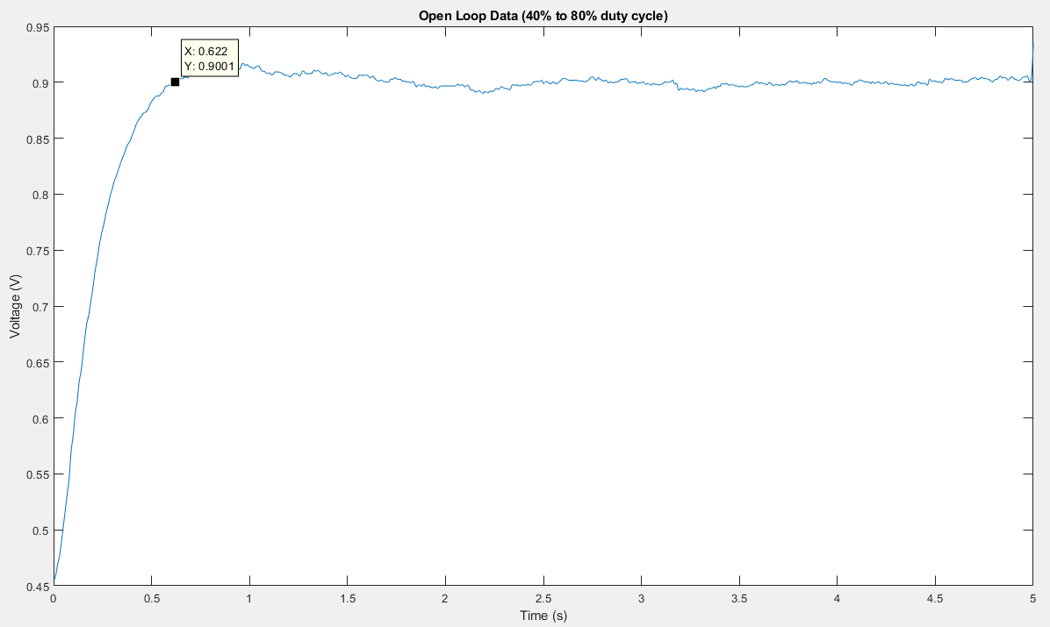
Open Loop Captured Data
622 ms

Slide 11
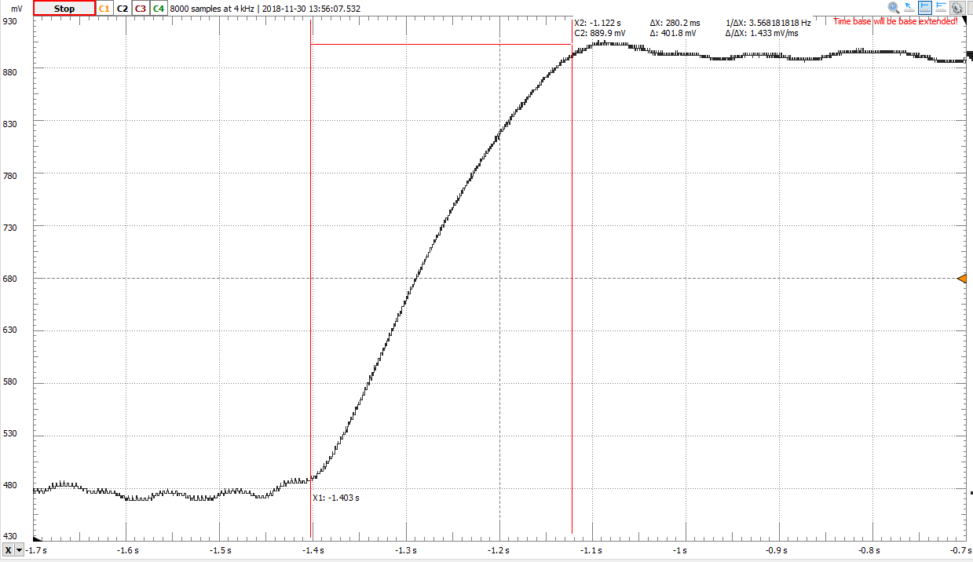
Closed Loop Captured Data
280.2 ms

Slide 12
Closed Loop Response Summary
Same transition from 480 mV to 900 mV
~50% faster settling time
Open loop: 620-640 ms
Closed loop: 280-300 ms
Minimal ripple (under 10 mV)
Possible improvements:
Scale up errors
Use MCU with FPU
Optimize error calculations/tuning interface

Slide 13
Questions?

